Slide 1


Personalized Transfer of User Preferences for Cross-domain Recommendation
2022，WSDM

Slide 2
Introduction
In recent years, recommender systems have attracted amount of interest from industries and academia. However, most of these are hard to provide satisfying recommendations for new users who have no historical interactions.
Cross-domain Recommendation (CDR) which aims to transfer knowledge from source domain to target domain is a promising solution to alleviate the cold-start problem. Many existing CDR methods assume that all users share the same relationships between user preferences in the source and target domain, and learn a common preference.

Slide 3
Introduction
Due to individual differences, the complex relationships between the user preferences of the source and target domains vary from user to user. Hence, it is hard for a single bridge to capture such complicated and various relationships, which may degrade CDR performance.
To alleviate the drawback, it is necessary to use personalized bridges to model various relationships between user preferences in different domains. In other words, the process of preference transfer should be personalized.

Slide 4
Contributions
We propose a novel framework named Personalized Transfer of User Preferences for Cross-domain Recommendation (PTUPCDR), utilizing a meta network to generate personalized bridge functions for each user, given the encoded users’ characteristics in the source domain.
To learn the meta network stably, we employ a task-oriented optimization procedure to alleviate the side effects of unreasonable users’ embeddings.
We conduct extensive experiments on three cross-domain tasks using Amazon review dataset to demonstrate the effectiveness and robustness of PTUPCDR.

Slide 5
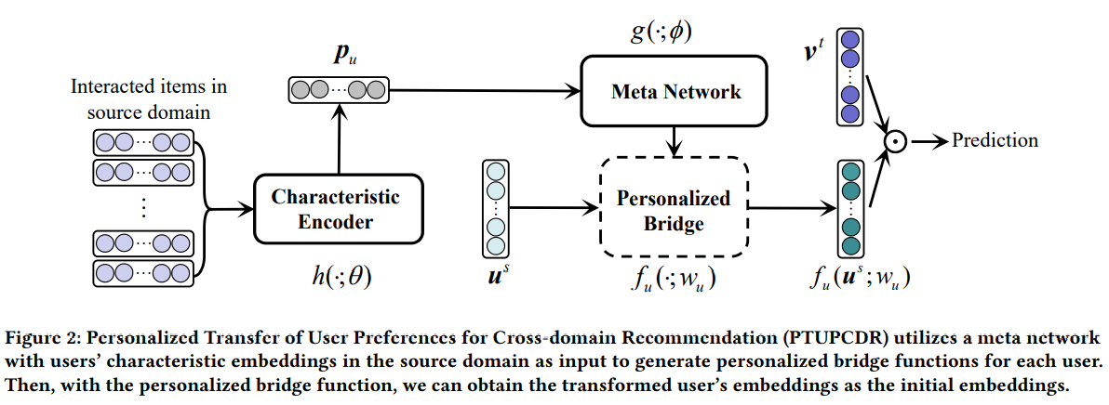
PTUPCDR

Slide 6

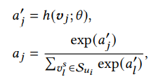
PTUPCDR
Characteristic Encoder
The first step to generate the personalized bridge function is to capture users’ personalized transferable characteristics from interacted items.
We propose to employ the attention mechanism on item embeddings by performing a weighted sum:
where p denotes the transferable characteristic embedding of user u, and α is the attention score for item v. We learn the attention score from the items’ embeddings by an attention network:

Slide 7




PTUPCDR
Meta Network
We propose a meta network which takes the user’s transferable characteristics as input, and then generates a personalized bridge function between the user’s embeddings in the source and target domains.
With the personalized bridge function, we can obtain the personalized transformed user’s embeddings:
where denotes the embedding of user 𝑢 in the source domain, and represents the transformed embedding.

Slide 8

PTUPCDR
Task-oriented Optimization
We propose a task oriented optimization to train the meta network and characteristic encoder. The task-oriented training procedure directly utilizes the performance of the ultimate recommendation task as the optimization goal.

Slide 9
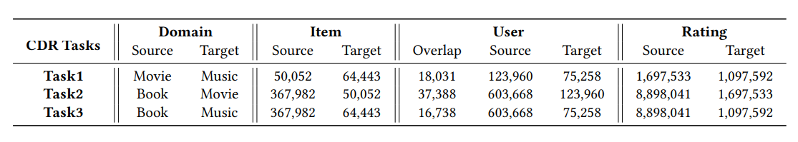
Experiment
Datasets:

Slide 10
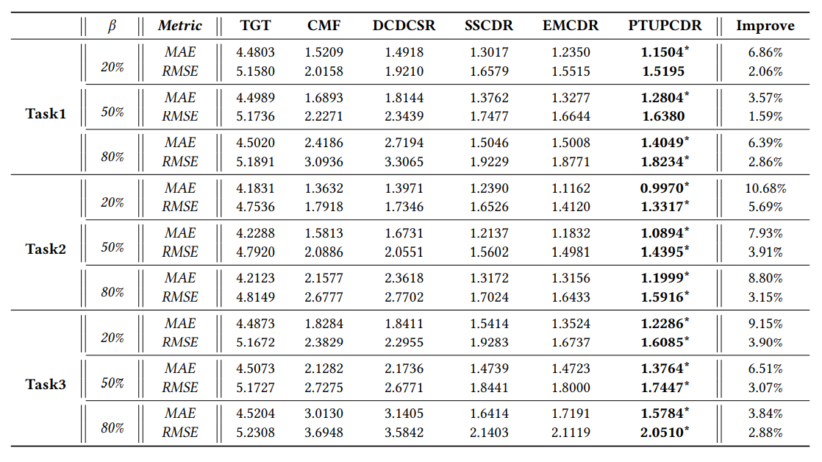
Experiment
2. Cold-start results

Slide 11
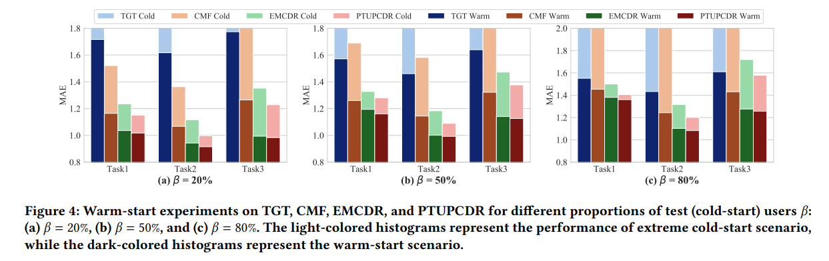
Experiment
3. Warm-start results

Slide 12
Conclusions
We proposed a novel framework named Personalized Transfer of User Preferences for CDR (PTUPCDR). A meta network fed with users’ characteristic embeddings is learned to generate personalized bridge functions to achieve personalized transfer of user preferences.
Experiments results on real-world datasets validate the effectiveness of PTUPCDR on both cold-start and warm-start stages.

Slide 13

Thank you!

